Slide 1
A Review of Modern Physics: PHYS 505
Brought to you by: UNH sps
December 10, 2016

Slide 2
Special Relativity: Basic Principles
Light moves at the same speed in all reference frames.
All laws of physics are the same in all reference frames.

Slide 3


Special Relativity: Equations
Lorentz Transformations
Time Dilation and Length Contraction
x = $γ\left(x^{′}+vt^{′}\right)$
y = y’
z = z’
$t=γ(t^{′}+\frac{vx^{′}}{c^{2}})$
$γ=\frac{1}{√\left(1 −\frac{v^{2}}{c^{2}}\right)}$
$Δt=γΔt′$
Where $Δt$ is the
$l=l^{′}γ$
Where l is the “proper length”

Slide 4

Lorentz Velocity Transforms
$u_{x}^{′}=\frac{dx^{′}}{dt^{′}}=\frac{dx^{′}}{dt}\frac{dt}{dt^{′}}=\frac{u_{x}−c}{1 − \frac{u_{x}v}{c^{2}}}$
See your book for others

Slide 5

Relativity: Energy and Momentum
$E=mγc^{2}$
$K = E – mc^{2}$
$E^{2}=p^{2}c^{2}+{\left(mc^{2}\right)}^{2}$
$p=mγu$
$F=\frac{dp}{dt}$

Slide 6
Light: A Wave…. And a Particle?
Young’s Double Slit Experiment
Compton Scattering
Photoelectric Effect

Slide 7

Wave Nature of Matter
Double Slit with electrons (Davisson-Germer)
de Broglie:
$f=\frac{E}{h}$ and $λ=\frac{h}{p}$

Slide 8

Quantum Mechanics
$$ΔxΔp≥\frac{ℏ}{2}$$

Slide 9
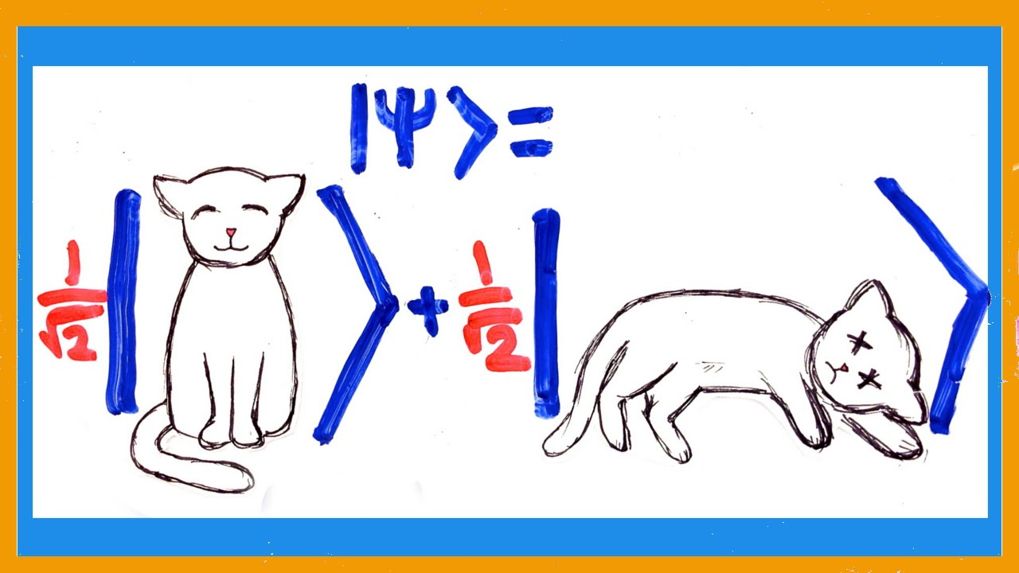

Born Interpretation
P(x) = ${\left|ψ\right|}^{2}$
$\int_{−∞}^{∞}{{\left|ψ\right|}^{2}dx}$ = 1

Slide 10

Expectation Values:
$⟨ Ĉ$ $⟩$ = $\int_{−∞}^{∞}{ψ^{∗ }Ĉ ψ dx}$
Example:
$⟨X⟩$ = $\int_{−∞}^{∞}{ψ^{∗ }x ψ dx}$

Slide 11

Time Dependent Schrödinger Equation in 1-D

Slide 12

The Time Independent Schrödinger equation in 1D
Infinite Square well:
Solve S.E.
Use Boundary Conditions

Slide 13
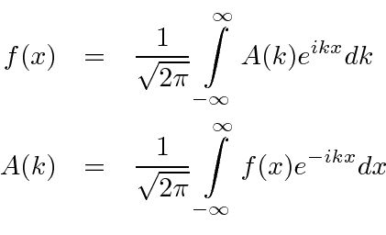
Fourier Transforms

Slide 14

Time Dependent Schrödinger equation in 3-D
Use Separation of variables.

